Slide 1
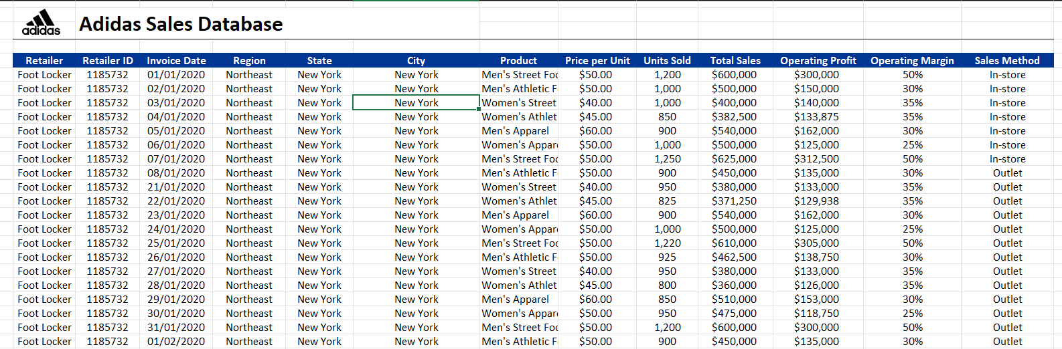
ADIDAS SALES IN THE UNITED STATES
The following graphical tools analyze the Adidas sales dataset using Microsoft Power BI.

Slide 2
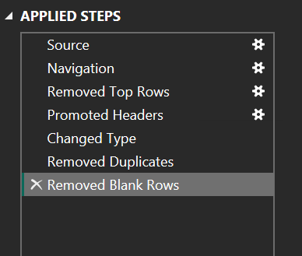
The dataset was first transformed and cleaned using the Power BI transform tool. The image below displays the steps.
The dataset was first imported, empty rows with Null values and duplicate values were removed, extra rows were deleted, and the first row was made header.

Slide 3

The above image shows cards that describe the data.

Slide 4
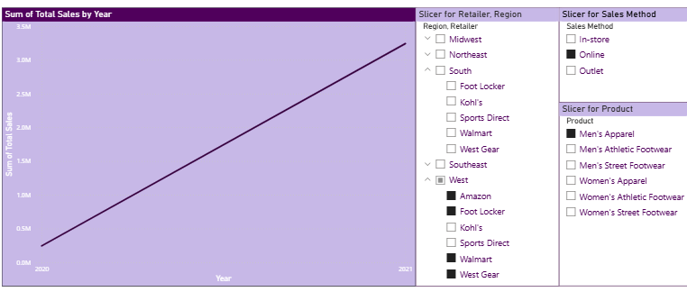
On the left is a line graph that describes the Sum of total Sales across the years. We can see that in Men’s apparel, with online shopping, and in the West of the US, considering only Amazon, Foot Locker, Walmart, and West Gear, the Sum of total sales has gradually increased in the past year by nearly 3.5 M dollars.

Slide 5
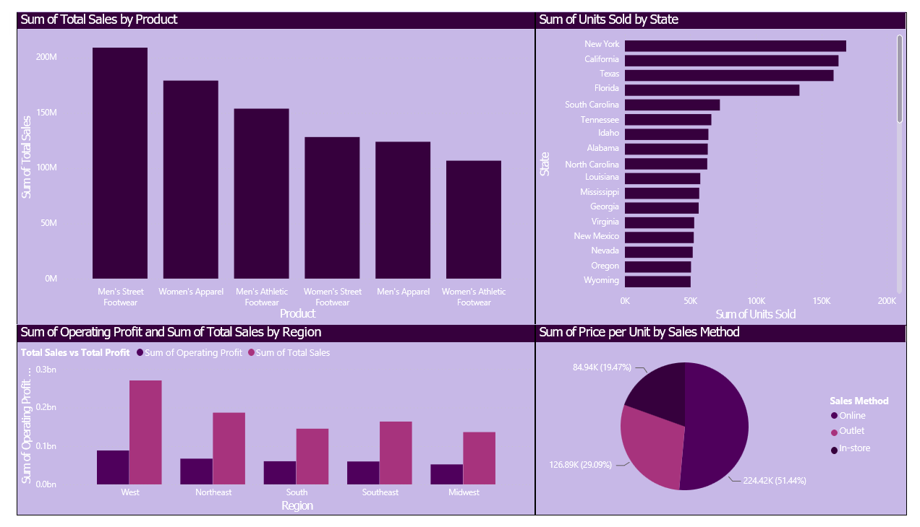

Slide 6
1. Sum of Total Sales by Product (Top Left):
Bar chart showing total sales by product type.
Men's Street Footwear has the highest sales, followed by Women's Apparel.
Women's Athletic Footwear has the lowest sales.
Helps identify top-performing product categories.
2. Sum of Units Sold by State (Top Right):
Horizontal bar chart displaying total units sold per state.
New York, California, and Texas lead in unit sales.
States like Wyoming and Oregon have the lowest sales.
Shows where most products are being sold geographically.
3. Sum of Operating Profit and Total Sales by Region (Bottom Left):
Grouped bar chart comparing operating profit and total sales by region.
West region shows the highest sales and profit.
Midwest and Northeast regions have lower sales and profit.
Useful for understanding regional performance differences.
4. Sum of Price per Unit by Sales Method (Bottom Right):
Pie chart showing share of price per unit by sales method.
In-store sales have the largest share (51.44%).
Outlet accounts for 29.09%, and Online for 19.47%.
Highlights the effectiveness of each sales channel.

